Slide 1
Non-contact heart rate and respiratory rate estimation from videos of the neck
Tianyu Zhang¹
Miodrag Bolic¹
Mohamad Hosein Davoodabadi Farahani¹
Terri Zadorsky²
Roland Sabbagh^{2,3}
¹School of Electrical Engineering and Computer Science, University of Ottawa
²Orleans Cardiopulmonary Group
³Montfort Hospital
Notes:
Heart Rate (HR) and Respiratory Rate (RR) estimation constitutes a crucial part of non-contact assessment of cardiovascular disease, which has been a leading cause of death worldwide. This paper proposes a novel HR and RR estimation algorithm based on RGB videos recorded by a smartphone camera. Instead of requiring facial videos, this novel algorithm demonstrates the ability to estimate HR and RR using only a video of the human neck. This novel algorithm captures cardiac as well as respiratory activity via detecting skin displacement by only analyzing the Laplacian pyramid of each frame of the video. Its performance was evaluated by applying it to the videos of neck of 80 participants and comparing it to existing methods, demonstrating the superior performance of the proposed algorithm.

Slide 2
Presentation outline
Objective
Methodology
Dataset
Related works on remote photoplethysmography (rPPG)
Results
Discussion and conclusion

Slide 3
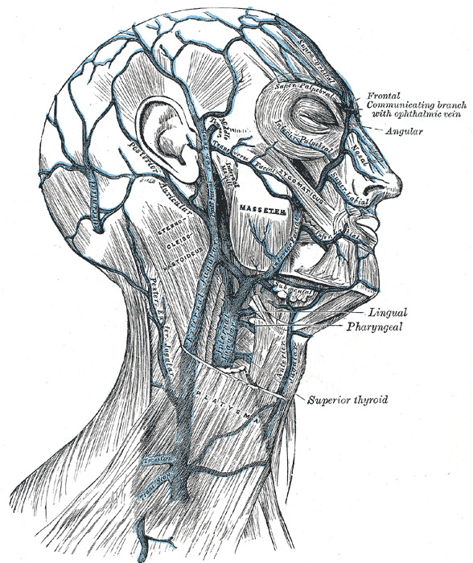
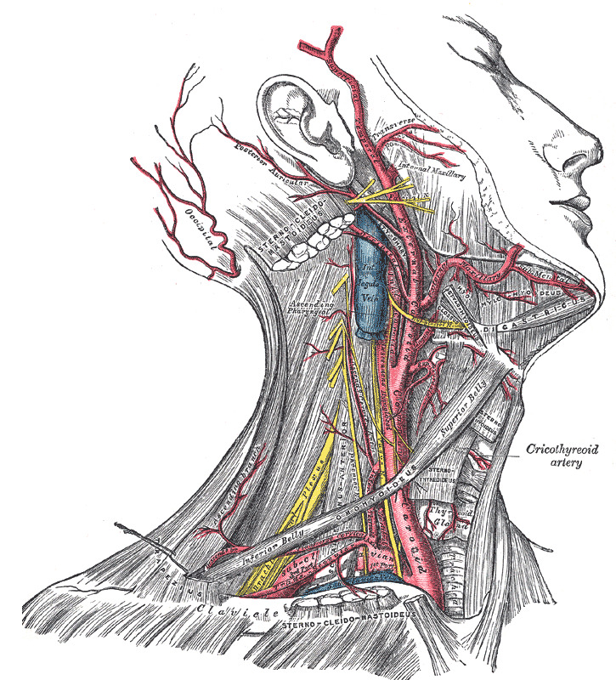
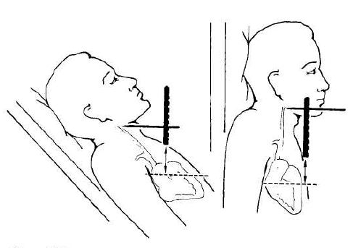
Objective: Heart rate and respiratory rate estimation through cardiac and respiratory activities of carotid artery and jugular veins
Veins of the Neck, Head, and Face, and Their Branches. Illustration of the veins of the neck, head, and face, and their branches, including the external and internal jugular vein. Henry Vandyke Carter, Public Domain, via Wikimedia Commons
Demonstration of measuring the Jugular Venous Pressure (JVP) with regard to the sternal angle of Louis [1]. The JVP can be used as a non-invasive alternative of the right atrial pressure.
Arteries of the Head and Neck, External Carotid, Internal Jugular Vein, External Maxillary, Henry Vandyke Carter, Public Domain, via Wikimedia Commons
[1] M. M. Applefeld, “The jugular venous pressure and pulse contour,” in Clinical Methods: The History, Physical, and Laboratory Examinations. Boston: Butterworths, 1990.
Notes:
In this slide I would like to introduce the ultimate objective of this project, which is the identification of the carotid artery and the internal jugular vein. The 2 images on the left hand side illustrate the anatomical locations of the main arteries and veins across the neck area, respectively. The image on the right demonstrates how the height of the internal jugular vein is measured, and that this height can be used as an alternative of the right atrial pressure, for which the gold standard is the pressure measured with catheterization.
Blood pressure fluctuations in the right internal jugular vein (IJV) are reflective of the pressure changes in the right atrium of the heart and have the potential of being an important marker for the diagnosis of various cardiovascular diseases, such as pulmonary hypertension, congestive heart failure, and tricuspid regurgitation. Such Pressure fluctuations can be captured with visual inspection by experienced physicians as the movements of the skin overlying the right IJV area on the neck. Inspired by that, this paper suggests the potential for an imaging system that records an RGB video of the right lateral neck and estimates the heart rate (HR) and respiratory rate (RR) only from the skin overlying the right IJV area.

Slide 4
Objective: Heart rate and respiratory rate estimation through cardiac and respiratory activities of carotid artery and jugular veins
Novelties of this study:
The data collection does not require special imaging equipment and lighting
The subjects include cardiac patients from the clinic and not healthy students as it is commonly the case
Exploiting the spatial distritubion of blood vessels underlying neck skin by dividing the neck area into sub-segments for increased accuracy of HR
On the left: An RGB video of the neck recorded from the right lateral perspective. On the right: red and blue signals illustrate cardiac signals extracted from the pixels with corresponding colors respectively, whereas green signals illustrate the respiratory signals extracted from the same pixels.
Notes:
In this slide I want to introduce the novelty of this study on the left, and a bit of reasoning of the proposed methods on the right.
In the video on the right hand side shows a video which demonstrates the capability of our videos to reveal cardiac and respiratory activities across the neck area. On the left hand side of the video plays the original video recorded with the smartphone, whereas on the right hand side shows the physiological signals extracted from the 2 pixels denoted with red and blue circles on the subject’s neck. The cardiac signals extracted from the red and blue pixels are shown in the plots as the curves with the corresponding colors, while the green curves in both plots are the respiratory signals extracted from the 2 pixels.

Slide 5
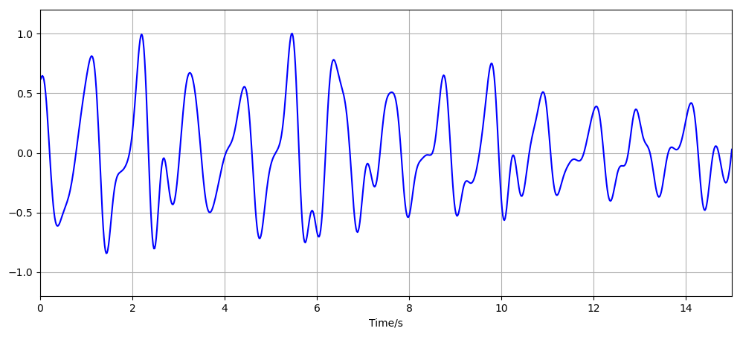
Methodology
Division of selected pixels into 10 equal sub-sections
Principle Component Analysis (PCA)
Approximation of heart rate
Multiscale analysis via Laplacian pyramid
Selection of pixels with top 50% frequency band power across [0.7, 3] Hz
Division of selected pixels into 10 equal sub-sections
Approximation of respiratory rate
Principle Component Analysis (PCA)
Pre-processing
Acquisition of temporal signal
Selection of pixels with top 50% frequency band power across [0.15, 0.5] Hz
Notes:
This flow chart is made on the basis of the flow chart in the paper.
The pre-processing block here (first block) corresponds to the first 2 blocks in the paper (including initial ROI identification and skin detection). The red rectangle illustrates the manually identified initial ROI, with the 2 red circles on the top left and bottom right corners showing the manually selected landmarks. The green-colored region illustrates the result of the skin detection algorithm.
For the other 2 images in the middle of the flow, the green regions illustrate the pixels with top 50% frequency band power of the corresponding frequency bands.

Slide 6
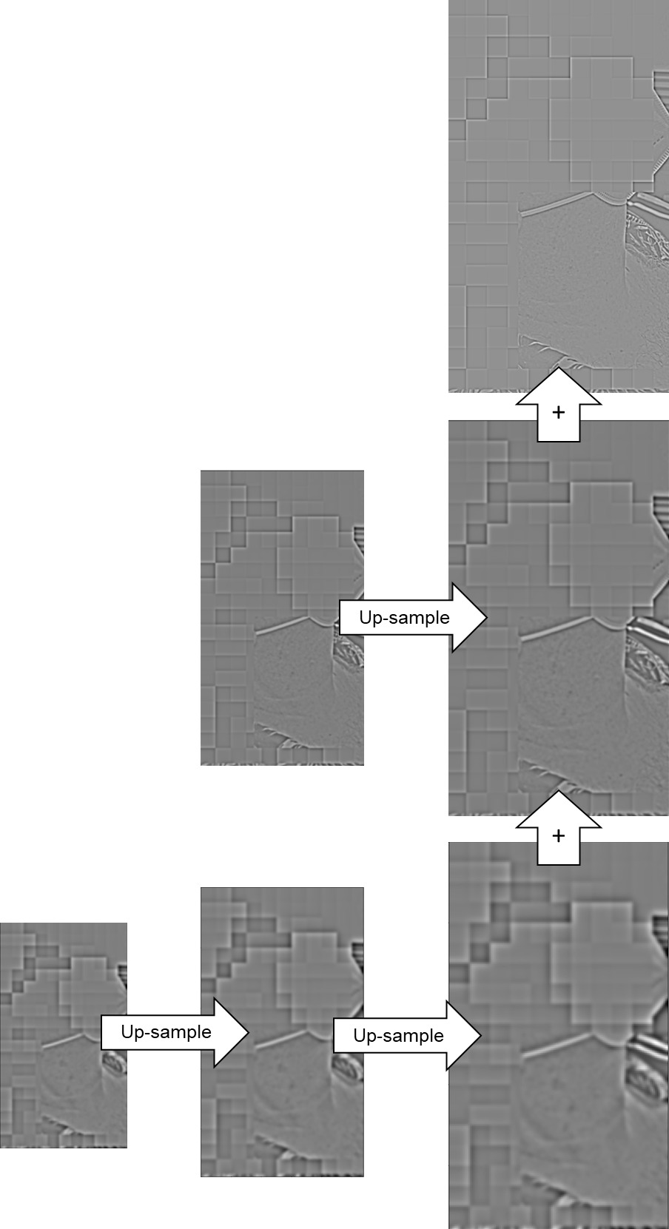
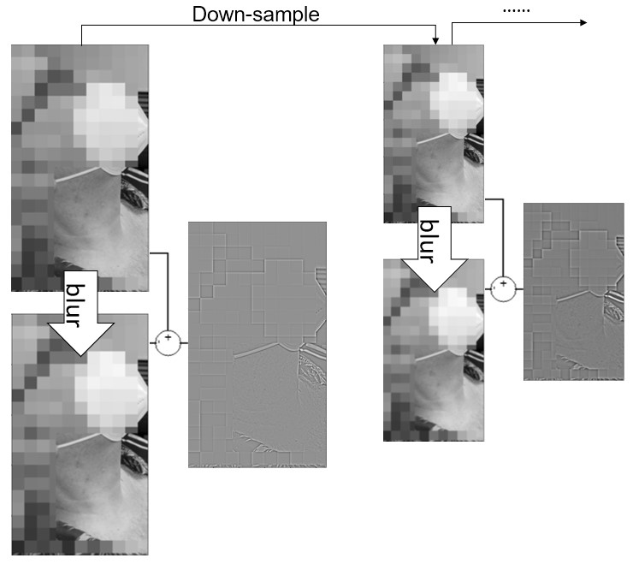
Methodology: multiscale analysis via Laplacian pyramid
7-level Laplacian pyramid
Notes:
This page shows how the multiscale analysis of this algorithm works. On the left hand side illustrates the construction of the 6-level Laplacian pyramid. The text box in the middle explains that each frame of the video is decomposed into a 6-level Laplacian pyramid. On the right hand side, the flow chart illustrates the reconstruction of the pyramid, and eventually the temporal signals of each pixel will be the sequence of its illuminance values after reconstruction.

Slide 7
Dataset
 | Video recording | Reference signals | Reference IJV location
Device | Google Pixel phone | Neurobit Optima+ 4, Neurobit systems | Vivid ultrasound system, GE Healthcare
Distance | About 30 cm
Length | 25 ~ 30 secs | Simultaneous with video
Information | 1080*1920 pixels, 60 fps, steadily fixed | ECG, PPG, and respiration signals | Bottom and top of IJV labelled; Operated by medical technicians
Information of data collection
Cohort | Gender | Age | Body surface area | Body mass index | Rhythm
80 | 44 male | 59.6 ± 15.5 | 1.9 ± 0.2 | 28.7 ± 6.3 | 73 sinus rhythm
 | 36 female |  |  |  | 2 PVC, 1 PAC
 |  |  |  |  | 4 atrial fibrillation
Demographic information of the cohort
Notes:
The first table shows information of the data collection process. The column “video recording” explains the smartphone configuration, distance from the subject, and the lengths of the videos. The column “reference signals” shows the information of the physiological signals recorded simultaneously with the videos. The last column explains that both the base (the lowest point) and the taper (highest point) of the Internal Jugular Vein (IJV) are labelled by medical technicians.
The second table shows the demographic information of our 80 participants.

Slide 8
Related works on remote photoplethysmography (rPPG)
Chrominance-based method (CHROM) | PBV | PBV-PCA | Plain-Orthogonal-to-Skin (POS) | Spatial Subspace Rotation (2SR)
Proposal of a Chrominance-based method with skin tone standardization Using spatial average of color channels Production of rPPG signal from difference between color channels | Proposal of the normalized blood-volume pulse vector $\vec{P_{BV}}$ Using spatial average of color channels Correlation between the produced rPPG and the color channels equals $\vec{P_{BV}}$ | Using a reference weight vector resulting from the PBV method as the guidance of the principal component selection | Projecting both spatially and temporally averaged color channels to a plane orthogonal to the skin tone Using spatial average of color channels as well as temporal average across short time windows | Construction of a subspace of skin-pixels in RGB space The extraction of rPPG signal from the temporal rotation of the subspace Exploiting the spatial distribution of the skin-pixels
Notes:
This page briefly introduces the 5 related works whose results will be compared to those of the proposed method.
In order to fairly compare the methods to the proposed method, the data went through the same pre-processing step for all the methods as shown in the diagram on slide 5, which includes the ROI identification and skin detection.

Slide 9
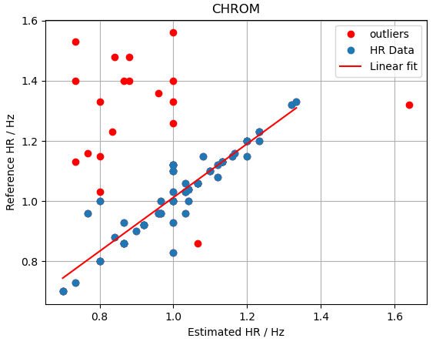
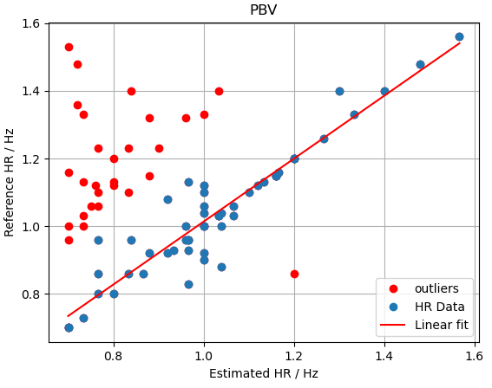
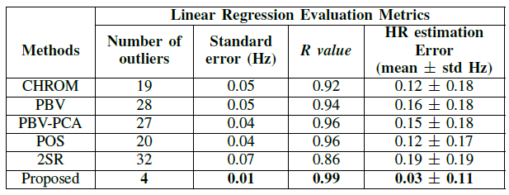
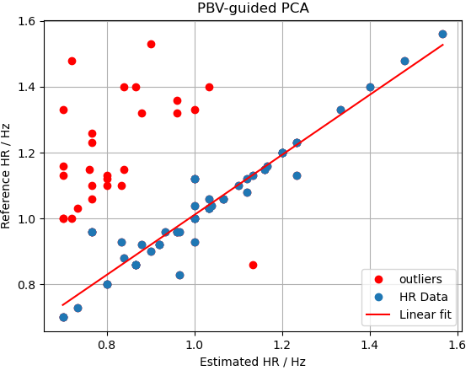
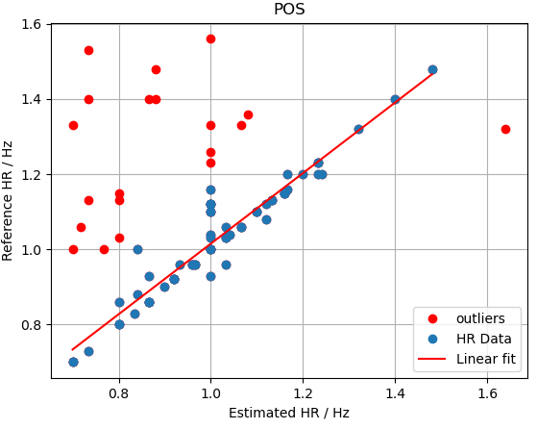
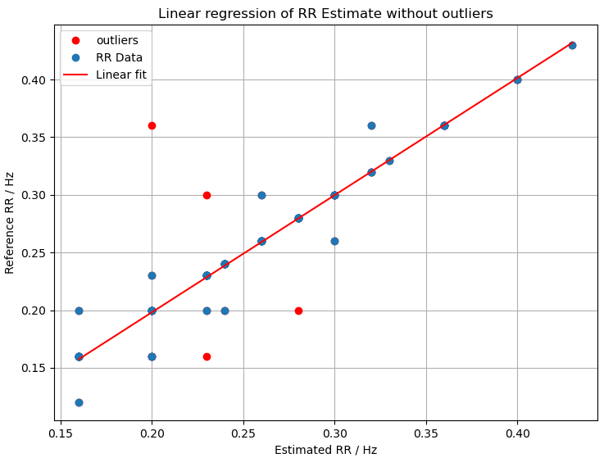
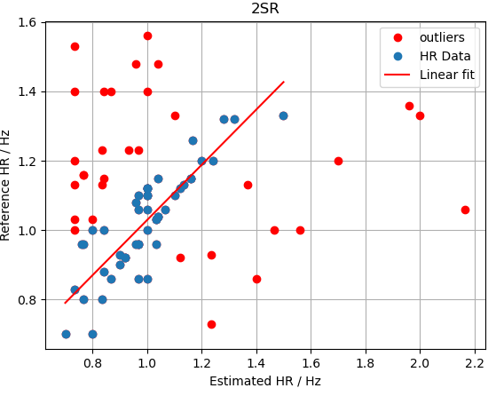
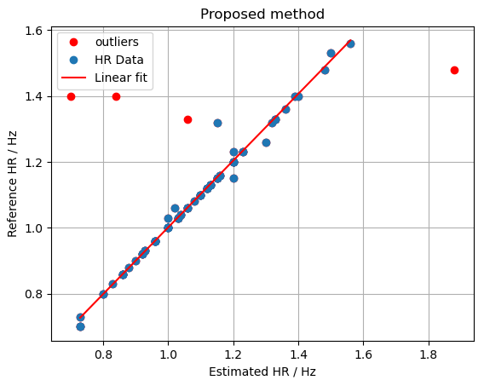
Results
Notes:
The table shows the comparison of HR estimation accuracy between the proposed method and the existing methods.
The figure in the left corner shows the results of the proposed respiratory rate estimation method. There is a significant linear correlation between the estimated RRs and the reference RRs.
The figures on the right illustrate the accuracy of the 5 existing HR estimation methods and the proposed method as the relation between the estimated HR on the x-axis and the reference HR on the y-axis. The blue dots denote data points included in the linear regression, and the red dots denote outliers.

Slide 10
Discussion and conclusion
Accuracy of proposed heart rate estimation method is superior to those of the existing methods, suggesting its better suitability to the human neck video scenario
Two out of four outliers correspond to sinus rhythmic cases, indicating the incapacity of the proposed method to identify cardiac activities in cases with visually less obvious pulsation
Two out of four Atrial Fibrillation (AF) cases constitute outliers, indicating the disadvantage of the proposed method on AF cases
Sensitivity of the proposed methods to disrupting motions is unknown due to the lack of data with significant artefacts or camera motion
Manual selection of landmarks for Region of Interest identification is still required; there is possibility for fully automatic HR/RR estimation algorithm in future endeavours

Slide 11
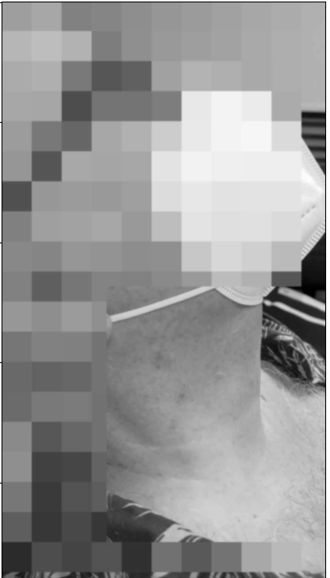
blur

